Slide 1

COOKR HACKATHON 2024
RAVI KANNAN C
GOKUL KRISHNA K

Slide 2
Statement - Kitchen Review Summary.
Steps followed:
1.Data Collection: Gather the customer reviews data from various sources.
2.Data Preprocessing: Clean and preprocess the text data to remove noise and irrelevant information.
3.Text Analysis: Analyze the preprocessed text to identify key topics, sentiments, and common phrases.
4.Summarization: Generate a summary of the reviews based on the analysis results.
5.Evaluation: Evaluate the quality of the generated summaries and iterate on the algorithm if necessary.

Slide 3
Algorithm
Import Libraries:
Import the regular expression library (re) for text preprocessing.
Define Dummy Customer Reviews Data:
Define a list reviews containing dummy customer reviews.
Define Text Preprocessing Function:
Define a function preprocess_text(text) to preprocess the input text:
Convert the text to lowercase.
Remove punctuation using regular expressions.
Remove stopwords manually.
Return the preprocessed text.

Slide 4
Contd….
Preprocess the Reviews:
Iterate through each review in the reviews list.
Preprocess each review using the preprocess_text function.
Store the preprocessed reviews in a new list preprocessed_reviews.
Print Preprocessed Reviews:
Print the preprocessed reviews to display the results of text preprocessing.
Define Sentiment Analysis Function:
Define a function analyze_reviews(reviews) to analyze the sentiment of the reviews:
Combine all preprocessed reviews into a single string.
Tokenize the combined reviews into words.
Perform frequency analysis to identify common phrases.
Identify positive and negative words for sentiment analysis.
Perform sentiment analysis on each review:
Count positive and negative words in each review.
Calculate the sentiment score for each review.
Calculate the average sentiment score across all reviews.

Slide 5
Contd….
Define Positive and Negative Words:
Define sets of positive and negative words used for sentiment analysis.
Analyze the Preprocessed Reviews:
Call the analyze_reviews function with the preprocessed reviews as input to perform sentiment analysis.

Slide 6
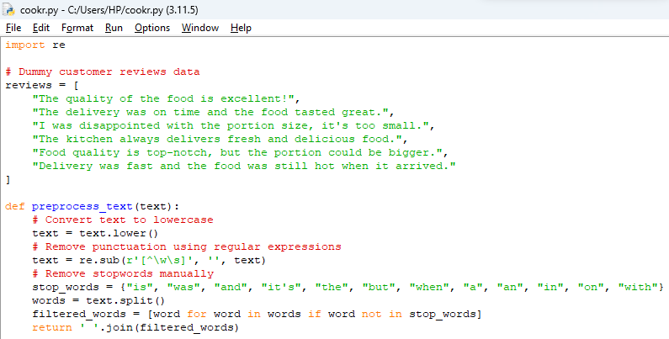

Slide 7
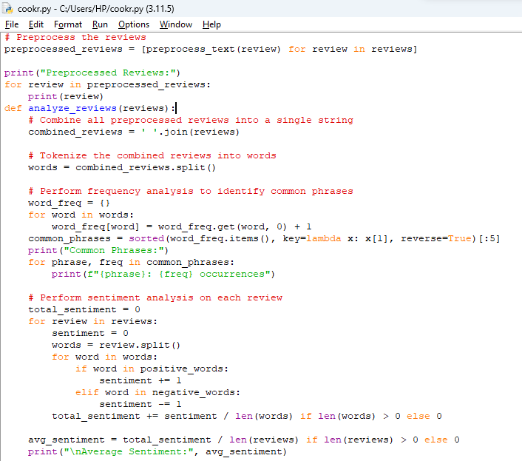

Slide 8
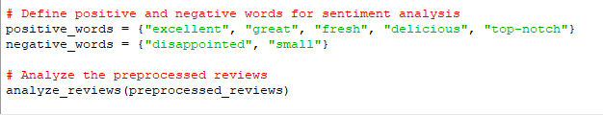

Slide 9
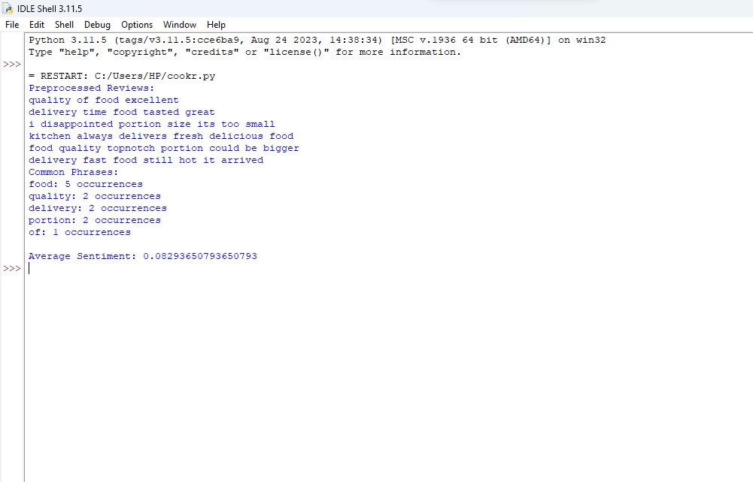
Output

Slide 10
2.Kitchen Description Builder
Introduction: Start with a brief introduction that sets the context for the kitchen description. This can include mentioning the name of the kitchen or the chef, if applicable.
Cuisine Specialization: Highlight the primary cuisine type that the kitchen specializes in. This helps set the tone for the description and gives the reader an immediate understanding of the type of food offered.
Unique Selling Point: Mention a unique aspect or selling point of the kitchen. This could be anything that sets it apart from others, such as the use of organic ingredients, adherence to traditional cooking methods, or a focus on authenticity.
Quality or Taste: If possible, include a statement about the quality or taste of the dishes served. This can help create anticipation and interest in trying out the kitchen's offerings.

Slide 11
Kitchen Description Builder
5.Text Generation: Based on the extracted information, generate concise descriptions highlighting the cuisine type, specialization, and unique aspects of the kitchen. Ensure that the generated text is clear, engaging, and fits within 2-3 lines on a mobile screen.

